Slide 1
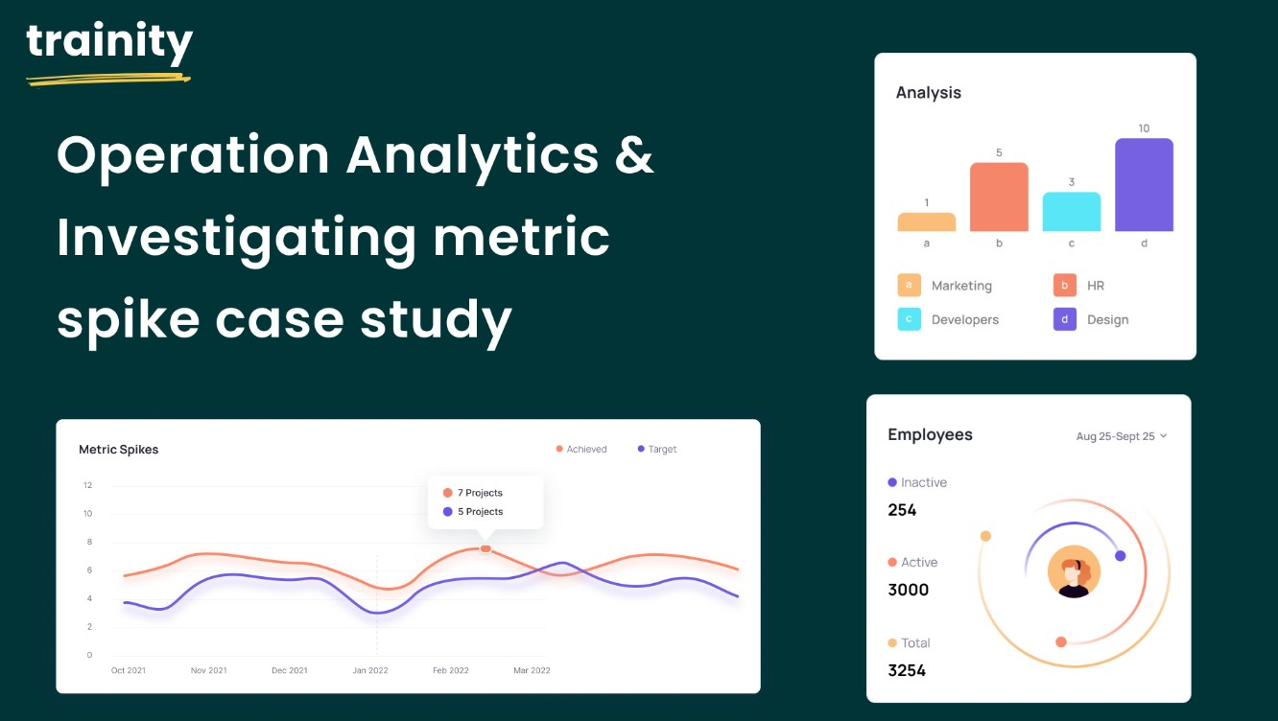
Operation Analytics and Investigating Metric Spike
Case Study 1 :
Job Data Analysis
Case Study 2 : Investigating Metric Spike
By - Anindya Das

Slide 2
Project Description
The project's objective is to leverage operational analytics for end-to-end company operations analysis, identify improvement areas, and provide actionable insights to cross-functional teams. As the data analyst lead at Microsoft, I will collaborate closely with departments like operations, support, and marketing to derive valuable insights from their data. The primary focus is on optimizing workflows, enhancing automation, and predicting the company's overall growth or decline. Additionally, the project will involve analyzing metric spikes in daily engagement and sales, investigating their causes, and providing insights to address any dips in these metrics.

Slide 3
Approach
This project focuses on gathering data sets from various departments and ensuring quality and normalization for import into an SQL database. We will use SQL queries to analyze the data and uncover patterns, trends, and anomalies. Key performance metrics like daily engagement, sales, and customer satisfaction will be identified with cross-functional teams and tracked using SQL. Spikes in these metrics will be investigated through SQL subqueries, analyzing historical data, and collaborating for context. The insights gained will drive process improvements, optimize workflows, and support automation efforts.

Slide 4
Tech-Stack Used
Used mysql workbench 8.0 CE which is owned by Oracle

Slide 5
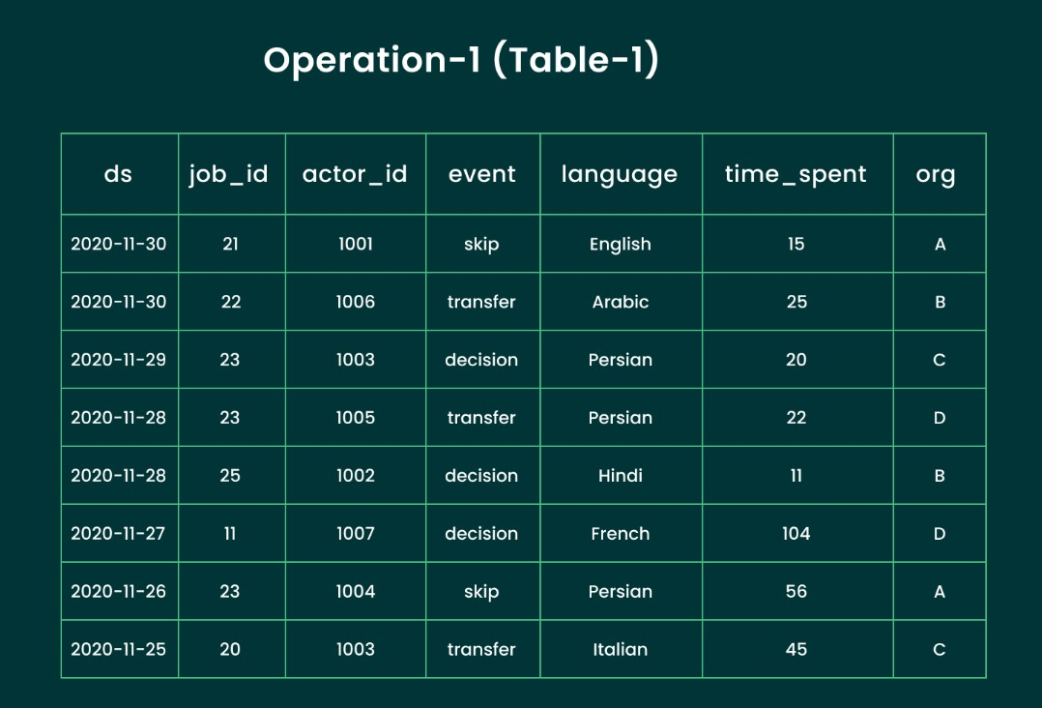
Case Study 1 : Job Data Analysis
table name : job_data

Slide 6
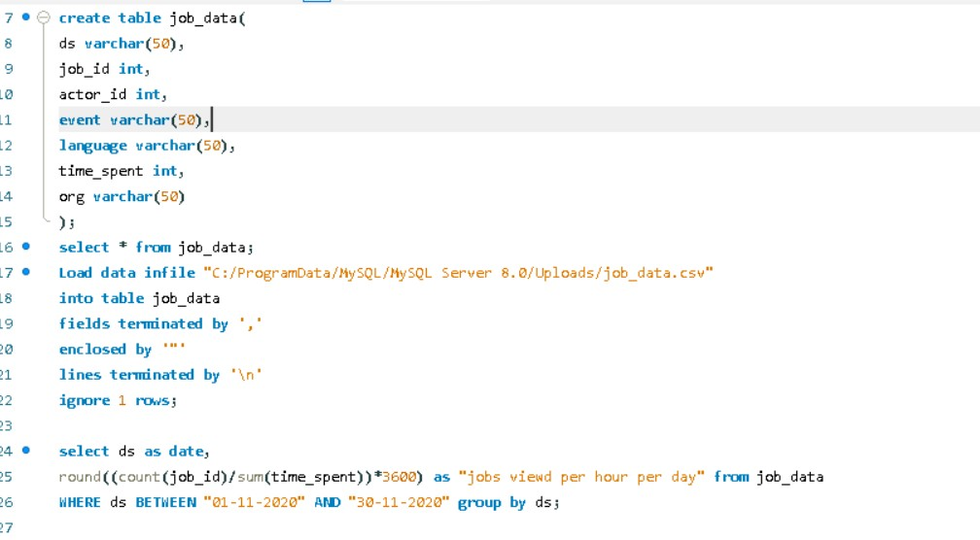
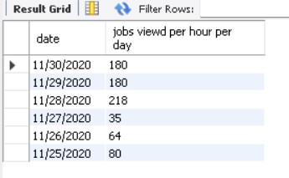
Jobs Reviewed Over Time :
Objective : Calculate the number of jobs reviewed per hour for each day in November 2020.
Result
Jobs reviewed per hour for each day in November 2020 – Query

Slide 7
*Insights : In November 2020, job review activity varied significantly, with some days showing higher engagement than others. Investigating potential factors influencing this fluctuation, such as technical issues like website outages or slow loading times is crucial. External factors, like holidays or promotions, may have also impacted user activity. Analyzing user feedback during this period can help identify challenges and improve future engagement.

Slide 8


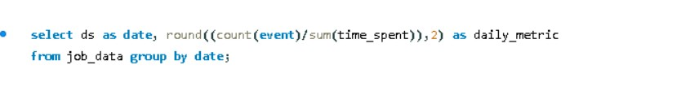
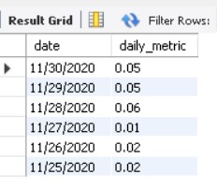
Throughput Analysis :
Objective : Calculate the 7-day rolling average of throughput (number of events per second).
7-day rolling average of throughput - Query
Result
Daily metric
Result

Slide 9
*Insights : The 7-day rolling average of throughput offers a clearer perspective on data trends, helping to mitigate the impact of daily variations. Maintaining the use of this rolling average for throughput analysis is recommended, as it yields a more consistent portrayal of performance trends. This approach aids in recognizing long-term patterns and facilitates more informed decision-making.

Slide 10

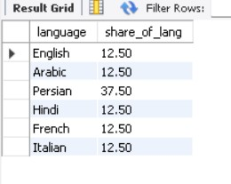
Language Share Analysis :
Objective : Calculate the percentage share of each language in the last 30 days.
The percentage share of each language over the last 30 days - Query
Result

Slide 11
*Insights : The language distribution in the last 30 days is relatively balanced, with Persian having the highest share. To enhance user engagement, consider investing in language-specific content or features for those languages that have lower representation. This targeted approach can help cater to diverse audience needs and improve overall interaction.

Slide 12


Duplicate Rows Detection :
Objective : Identify duplicate rows in the data.
Duplicate rows - Query
Result

Slide 13
*Insights : There is one duplicate row in the data based on the actor_id column. To maintain data integrity, it's essential to implement data validation mechanisms that prevent such duplicates in the future. This could include checks during data entry, unique constraints in the database, and regular audits to ensure the uniqueness of key identifiers. Taking these steps will help ensure cleaner data for analysis and reporting.

Slide 14
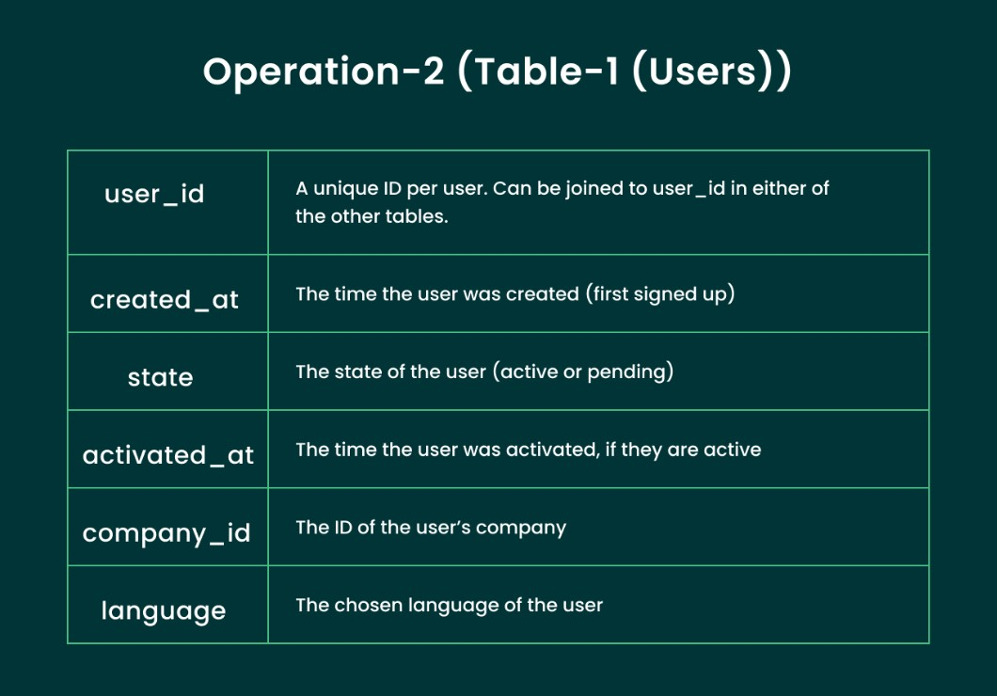
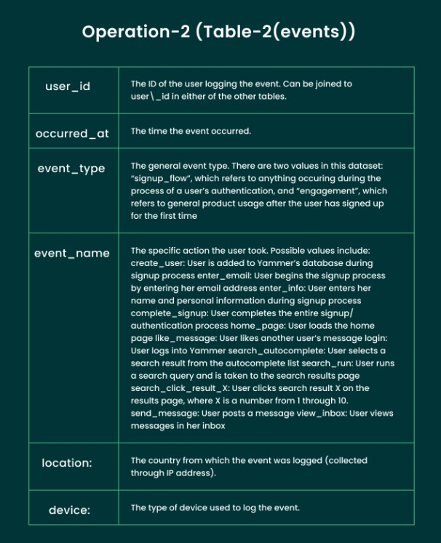
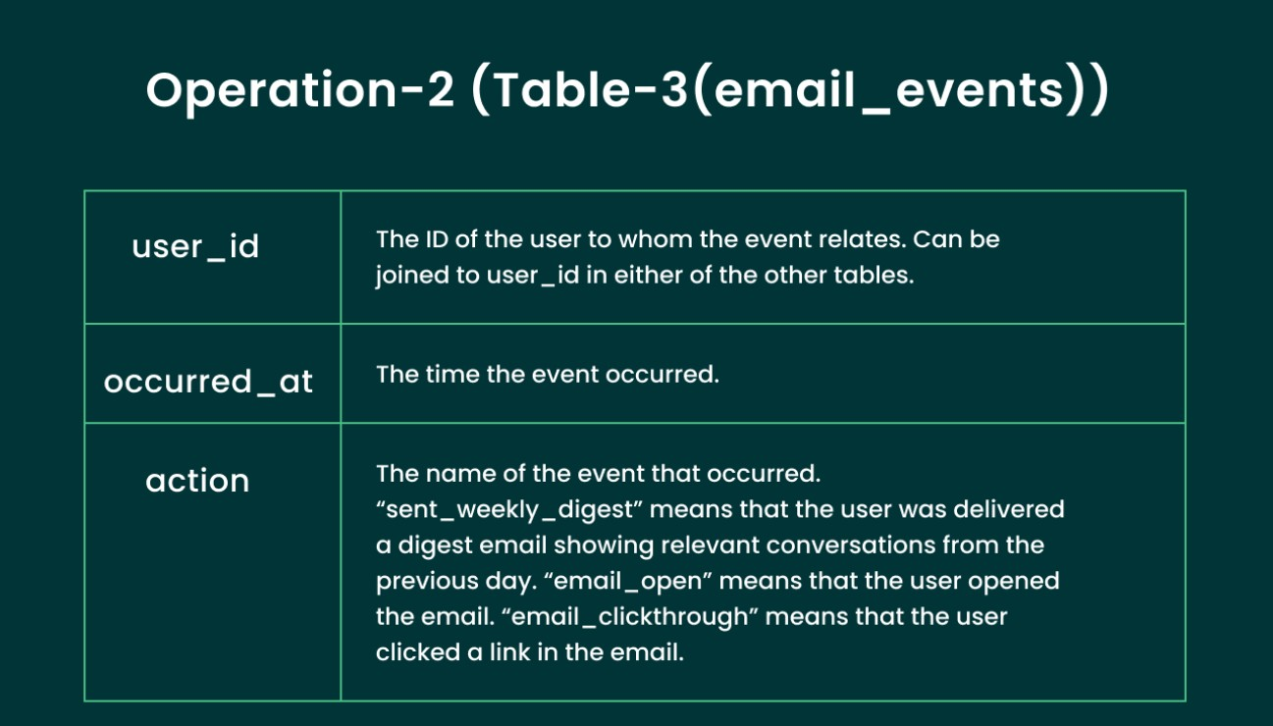
Case Study 2 : Investigating Metric Spike
Table name : users
Table name : email_events_table
Table name : events_table

Slide 15
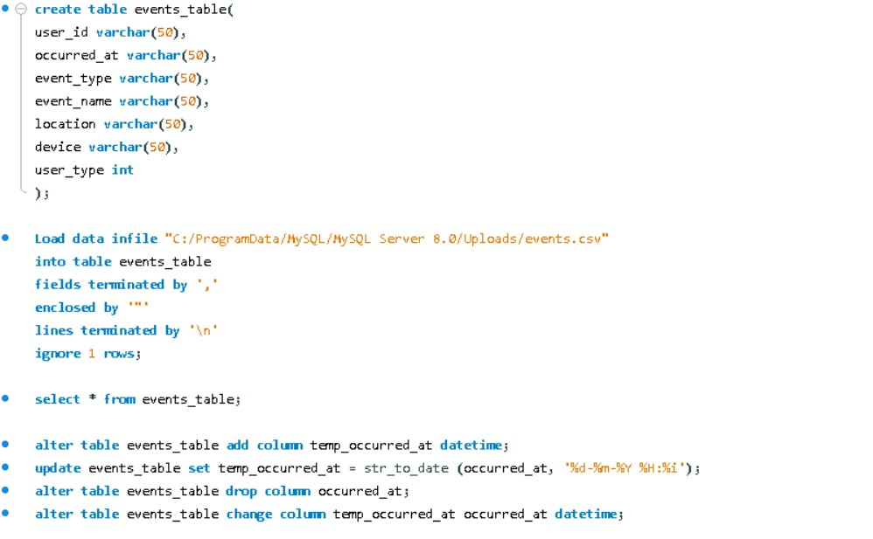
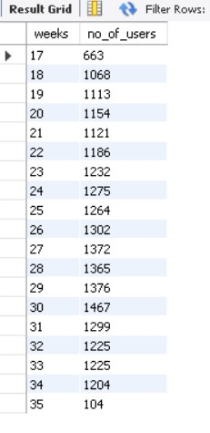
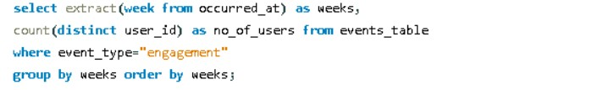
Weekly User Engagement :
Objective : Measure the activeness of users on a weekly basis.
events_table formation
Result
Weekly user engagement - Query

Slide 16
*Insights : User engagement peaked around week 30, displaying some fluctuations over the observed period. It’s important to investigate patterns associated with content updates, marketing campaigns, or any external events that might have influenced user behavior. These insights can help in planning future engagement strategies effectively.

Slide 17
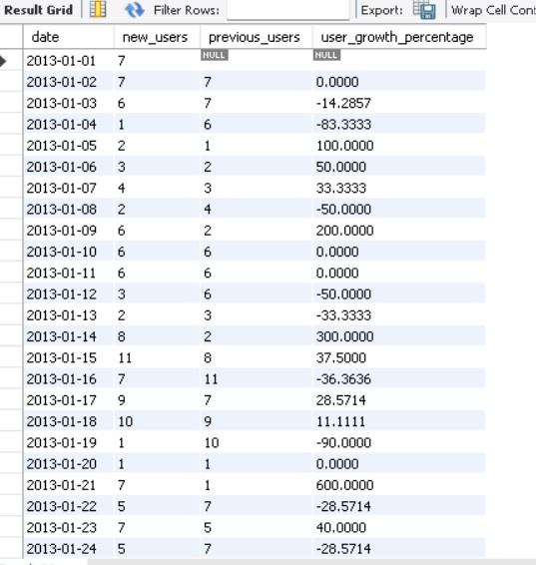
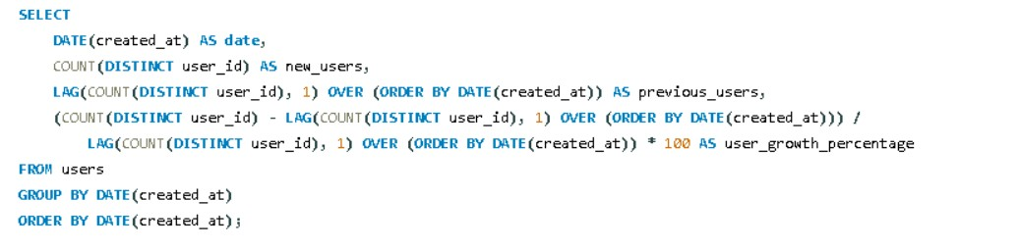
User Growth Analysis :
Objective : Analyze the growth of users over time for a product.
Growth of users over time - Query
Result - few outputs

Slide 18
*Insights : User growth has generally shown a positive trend over time, although there have been some fluctuations along the way. To fully understand this growth, it's essential to analyze the factors driving these changes. Look into periods of increased growth and see if they coincide with specific product updates, targeted marketing efforts, or emerging market trends. By identifying these correlations, it will be possible to replicate successful strategies that can help sustain and accelerate user growth in the future.

Slide 19
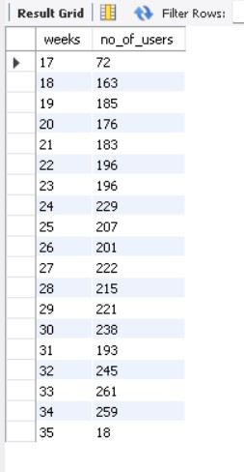
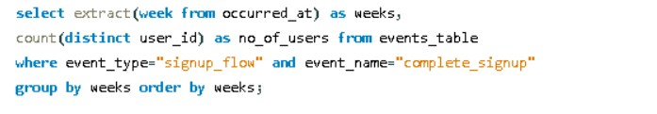
Weekly Retention Analysis :
Objective : Analyze the retention of users on a weekly basis after signing up for a product.
Weekly retention of users based on their sign-up cohort - Query
Result

Slide 20
*Insights : Weekly user retention shows a gradual decline over time. It’s essential to focus on improving user retention strategies. Identify key touchpoints in the user journey where users might be dropping off and work on enhancing user experience, engagement, and value during those stages. Implementing targeted interventions at these critical points can help in maintaining a loyal user base and fostering longer-term engagement.

Slide 21
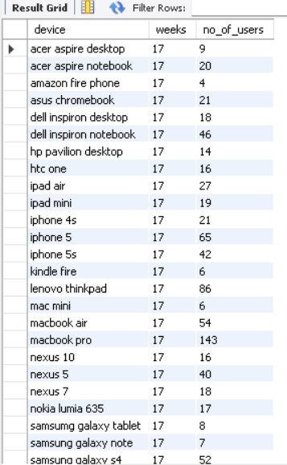
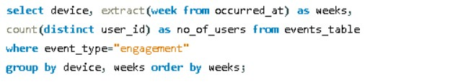
Weekly Engagement Per Device :
Objective : Measure the activeness of users on a weekly basis per device.
Weekly engagement per device - Query
Result - few outputs

Slide 22
*Insights : Engagement varies across different devices and weeks, with some devices consistently demonstrating higher engagement levels. It's advisable to optimize the user experience for those devices that show lower engagement. Additionally, keep an eye on device trends over time to adapt your strategies and focus on enhancing user engagement on devices that present the highest potential.

Slide 23
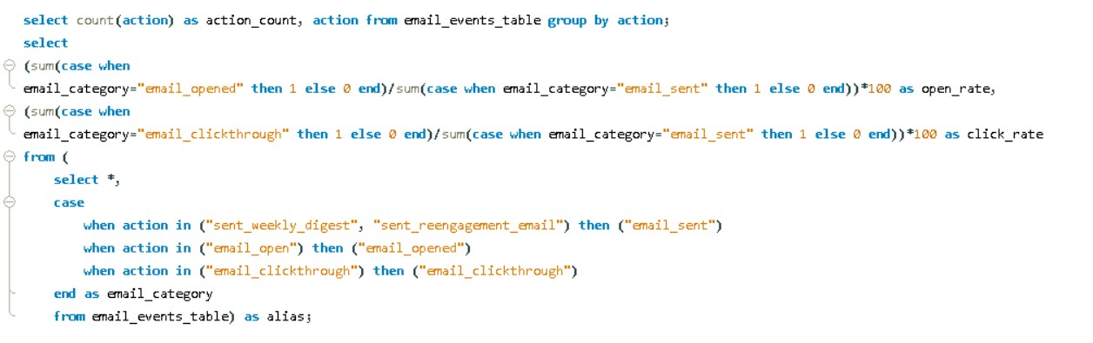
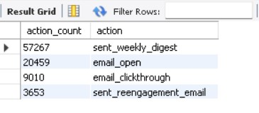

Email Engagement Analysis :
Objective : Analyze how users are engaging with the email service.
Result - action_count
Email engagement metrics - Query
Result

Slide 24
*Insights : The email engagement metrics indicate that the open rate is around 33.58% and the click rate is approximately 14.79%. To assess the effectiveness of these metrics, it's essential to compare them against industry benchmarks. If your engagement rates fall below average, think about enhancing various aspects of your emails, such as the content, subject lines, and targeting strategies, to boost engagement. Consistently testing and optimizing your email campaigns can lead to improved performance and better engagement rates over time.

Slide 25
Result
Working on this project has deepened my understanding of operational analytics and its methodologies. I've gained skills in merging and normalizing diverse datasets for accurate analysis and sharpened my SQL techniques to uncover insights. Collaborating with cross-functional teams has also improved my communication and teamwork abilities, allowing me to translate data findings into actionable recommendations for process optimization and contributing to the project's success.

Slide 26
THANK YOU !!

